Slide 1

Design and Analysis of Algorithms CSE 246
Notes:
‹#›

Slide 2
Sorting
Insertion sort
Design approach:
Sorts in place:
Best case:
Worst case:
Bubble Sort
Design approach:
Sorts in place:
Running time:
incremental
Yes
Θ(n)
Θ(n²)
incremental
Yes
Θ(n²)
‹#›
Notes:
‹#›

Slide 3
Sorting
Selection sort
Design approach:
Sorts in place:
Running time:
Merge Sort
Design approach:
Sorts in place:
Running time:
incremental
Yes
Θ(n²)
divide and conquer
No
Let’s see!!
‹#›
Notes:
‹#›

Slide 4
Divide-and-Conquer
Divide the problem into a number of sub-problems
Similar sub-problems of smaller size
Conquer the sub-problems
Solve the sub-problems recursively
Sub-problem size small enough ⇒ solve the problems in straightforward manner
Combine the solutions of the sub-problems
Obtain the solution for the original problem
‹#›
Notes:
‹#›

Slide 5
Merge Sort Approach
To sort an array A[p . . r]:
Divide
Divide the n-element sequence to be sorted into two subsequences of n/2 elements each
Conquer
Sort the subsequences recursively using merge sort
When the size of the sequences is 1 there is nothing more to do
Combine
Merge the two sorted subsequences
‹#›
Notes:
‹#›

Slide 6
Merge Sort
p
q
r
1
2
3
4
5
6
7
8
Alg.: MERGE-SORT(A, p, r)
if p < r Check for base case
then q ← ⎣(p + r)/2⎦ Divide
MERGE-SORT(A, p, q) Conquer
MERGE-SORT(A, q + 1, r) Conquer
MERGE(A, p, q, r) Combine
Initial call: MERGE-SORT(A, 1, n)
5
2
4
7
1
3
2
6
‹#›
Notes:
‹#›

Slide 7
Example – n Power of 2
Divide
1
2
3
4
5
6
7
8
5
2
4
7
1
3
2
6
q = 4
1
2
3
4
5
6
7
8
5
2
4
7
1
3
2
6
1
2
3
4
5
6
7
8
5
2
4
7
1
3
2
6
1
2
3
4
5
6
7
8
5
2
4
7
1
3
2
6
‹#›
Notes:
‹#›

Slide 8
Example – n Power of 2
Conquer
and
Merge
1
2
3
4
5
6
7
8
1
2
2
3
4
5
6
7
1
2
3
4
5
6
7
8
2
4
5
7
1
2
3
6
1
2
3
4
5
6
7
8
2
5
4
7
1
3
2
6
1
2
3
4
5
6
7
8
5
2
4
7
1
3
2
6
‹#›
Notes:
‹#›

Slide 9
Example – n Not a Power of 2
1
2
3
4
5
6
7
8
9
10
11
Divide
4
7
2
6
1
4
7
3
5
2
6
q = 6
1
2
3
4
5
6
7
8
9
10
11
q = 3
4
7
2
6
1
4
7
3
5
2
6
q = 9
1
2
3
4
5
6
7
8
9
10
11
4
7
2
6
1
4
7
3
5
2
6
1
2
3
4
5
6
7
8
9
10
11
4
7
2
6
1
4
7
3
5
2
6
1
2
4
5
7
8
4
7
6
1
7
3
‹#›
Notes:
‹#›

Slide 10
Example – n Not a Power of 2
Conquer
and
Merge
1
2
3
4
5
6
7
8
9
10
11
1
2
2
3
4
4
5
6
6
7
7
1
2
3
4
5
6
7
8
9
10
11
1
2
4
4
6
7
2
3
5
6
7
1
2
3
4
5
6
7
8
9
10
11
2
4
7
1
4
6
3
5
7
2
6
1
2
3
4
5
6
7
8
9
10
11
4
7
2
1
6
4
3
7
5
2
6
1
2
4
5
7
8
4
7
6
1
7
3
‹#›
Notes:
‹#›

Slide 11
Merging
p
q
r
1
2
3
4
5
6
7
8
2
4
5
7
1
2
3
6
Input: Array A and indices p, q, r such that p ≤ q < r
Subarrays A[p . . q] and A[q + 1 . . r] are sorted
Output: One single sorted subarray A[p . . r]
‹#›
Notes:
‹#›

Slide 12
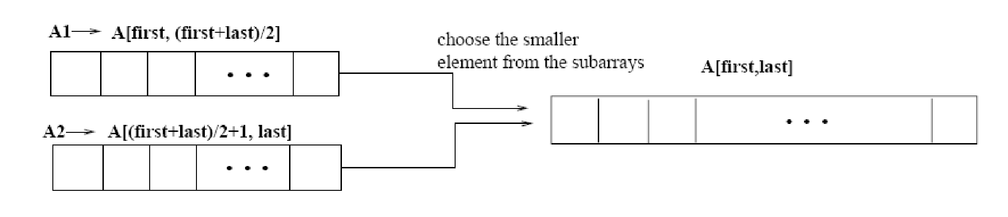
Merging
p
q
r
Idea for merging:
Two piles of sorted cards
Choose the smaller of the two top cards
Remove it and place it in the output pile
Repeat the process until one pile is empty
Take the remaining input pile and place it face-down onto the output pile
1
2
3
4
5
6
7
8
2
4
5
7
1
2
3
6
A1🡨 A[p, q]
A[p, r]
A2🡨 A[q+1, r]
‹#›
Notes:
‹#›

Slide 13
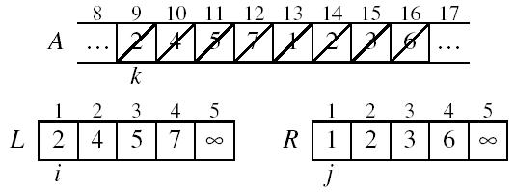
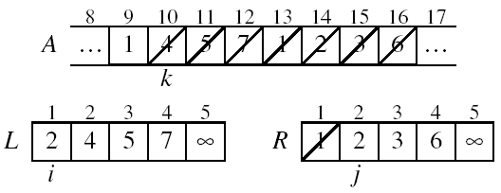
Example: MERGE(A, 9, 12, 16)
p
q
r
separate memory
replace in main array
‹#›
Notes:
‹#›

Slide 14
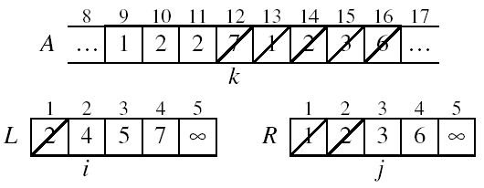
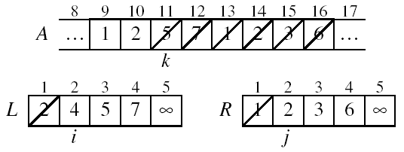
Example: MERGE(A, 9, 12, 16)
‹#›
Notes:
‹#›

Slide 15
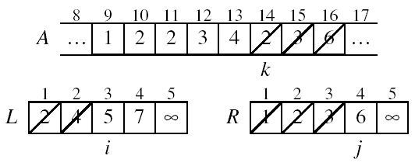
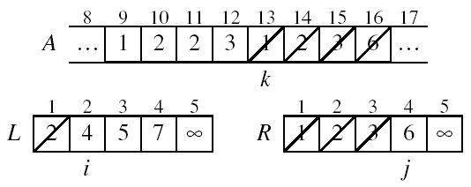
Example (cont.)
‹#›
Notes:
‹#›

Slide 16
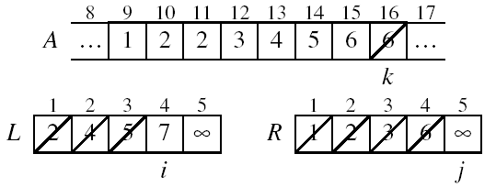
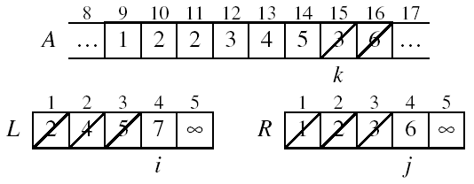
Example (cont.)
‹#›
Notes:
‹#›

Slide 17
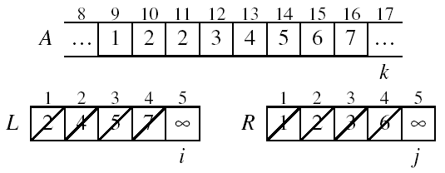
Example (cont.)
Done!
‹#›
Notes:
‹#›

Slide 18
Merge - Pseudocode
p
q
r
Alg.: MERGE(A, p, q, r)
Compute n₁ and n₂
Copy the first n₁ elements into L[1 . . n₁ + 1] and the next n₂ elements into R[1 . . n₂ + 1]
L[n₁ + 1] ← ∞; R[n₂ + 1] ← ∞
i ← 1; j ← 1
for k ← p to r
do if L[ i ] ≤ R[ j ]
then A[k] ← L[ i ]
i ←i + 1
else A[k] ← R[ j ]
j ← j + 1
1
2
3
4
5
6
7
8
2
4
5
7
1
2
3
6
n₁
n₂
p
q
L
2
4
5
7
∞
q + 1
r
R
1
2
3
6
∞
‹#›
Notes:
‹#›

Slide 19
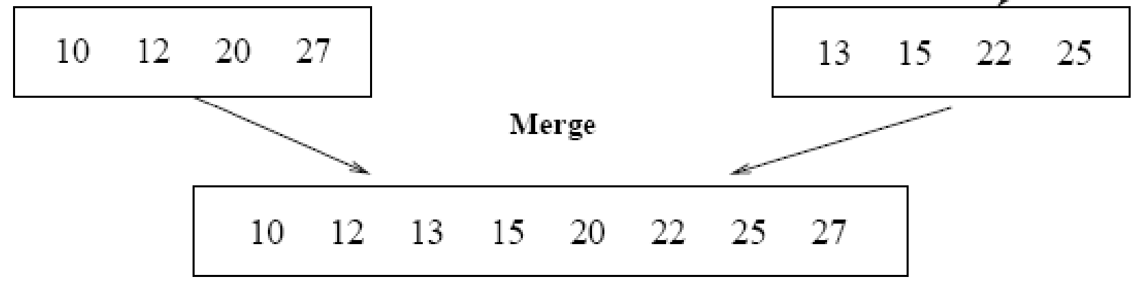
Running Time of Merge (assume last for loop)
Initialization (copying into temporary arrays):
Θ(n₁ + n₂) = Θ(n)
Adding the elements to the final array:
- n iterations, each taking constant time ⇒ Θ(n)
Total time for Merge:
Θ(n)
‹#›
Notes:
‹#›

Slide 20
Analyzing Divide-and Conquer Algorithms
The recurrence is based on the three steps of the paradigm:
T(n) – running time on a problem of size n
Divide the problem into a subproblems, each of size n/b: takes D(n)
Conquer (solve) the subproblems aT(n/b)
Combine the solutions C(n)
Θ(1) if n ≤ c
T(n) = aT(n/b) + D(n) + C(n) otherwise
‹#›
Notes:
‹#›

Slide 21
MERGE-SORT Running Time
Divide:
compute q as the average of p and r: D(n) = Θ(1)
Conquer:
recursively solve 2 subproblems, each of size n/2 ⇒ 2T (n/2)
Combine:
MERGE on an n-element subarray takes Θ(n) time ⇒ C(n) = Θ(n)
Θ(1) if n =1
T(n) = 2T(n/2) + Θ(n) if n > 1
‹#›
Notes:
‹#›

Slide 22
Solve the Recurrence
T(n) = c if n = 1
2T(n/2) + cn if n > 1
Use Master’s Theorem:
Compare n with f(n) = cn
Case 2: T(n) = Θ(nlgn)
merge sort complexity
‹#›
Notes:
‹#›

